Slide 1
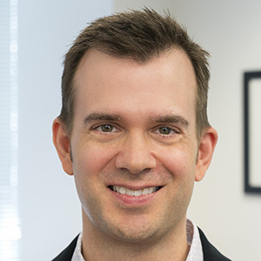

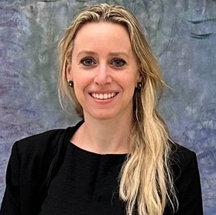
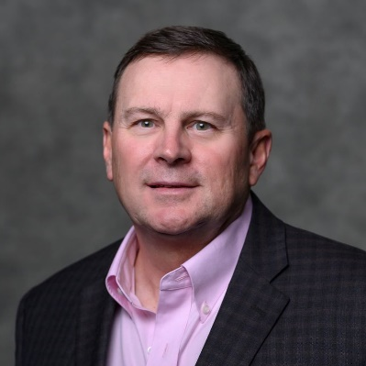
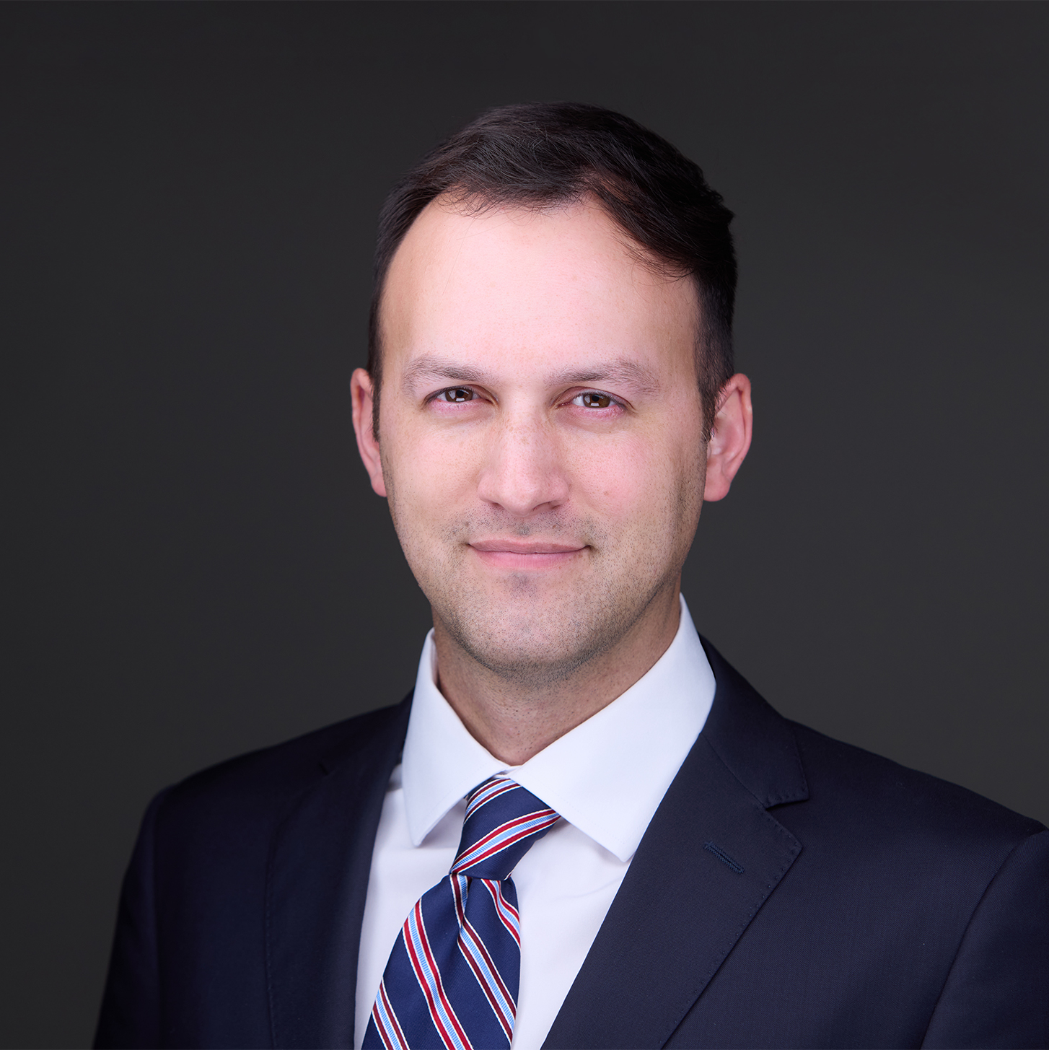
Our Speakers
Market Update & Trends
Scott Sergio
  Nixon Peabody LLP
  Moderator
Amanda Bloomberg
  National Trust Community Investment Corporation
Melissa McCormack
  JPMorgan Chase
John Sorel
  Foss & Company
Daniel Rolfe
  Bank of America

Slide 2
Panel topics
Market Update & Trends
Investor appetite for HTC investments
Understanding investor criteria
Sources in the capital stack—expectations, agreements, and execution
HTC-GO
Asset classes
Intersection of LIHTC and HTC projects
Office-to-residential conversions
Q&A

Slide 3
Market Update

Slide 4

ABOUT FOSS & COMPANY​
Since 1983, Foss & Company has been the premier federal and state tax equity sponsor to corporate America​
Over $9,000,000,000 in tax equity raised for LIHTC, Historic Rehabilitation and Renewable Energy​
Providing resources for corporate America to fulfill its Impact Investments goals and Sustainability initiatives​
Serving Life and P&C Insurance companies, Investment and Commercial Banks, Manufacturing and Distribution companies, Utilities, Retail, Technology and Telecoms​
Fully integrated firm with acquisitions, underwriting, asset management, and investor reporting teams for historic rehabilitation and renewable energy tax equity syndication​

Slide 5
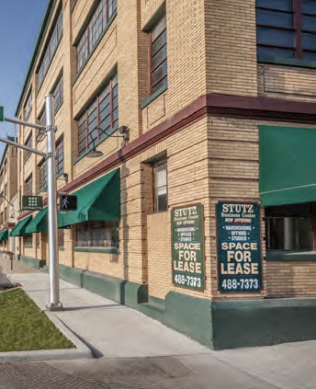
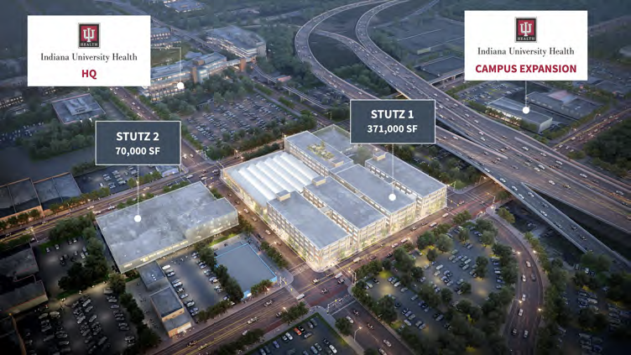
STUTZ BUILDING – Indianapolis, IN
ABOUT THE PROJECT:
DETAILS
41,000 square foot mixed-use restoration in downtown Indianapolis will feature 12,000 square feet of retail and dining space
The rest of the space will be reserved for ~27,000 square feet of co-working space, 17,000 square feet of event space, and 15,000 square feet of fitness and lifestyle space
The building will also feature a car museum, paying homage to its original use
This project is expected to deliver a total of $11,607,820 of 2023, 2024 and 2025 Federal Historic Tax Credits along with $7,000,000 in 2022 Indiana State Historic Tax Credits
Historic building is located in the NW quadrant of downtown Indianapolis, an area known for having a strong presence of education and medical services
Tenants are set to include famous local hotspots Amelia’s Bakery and Café Patachou
Barista Parlor is a coffee shop is known for its affiliation with motorcycles and collectible cars which fits in perfectly with the history of the Stutz building.

Slide 6

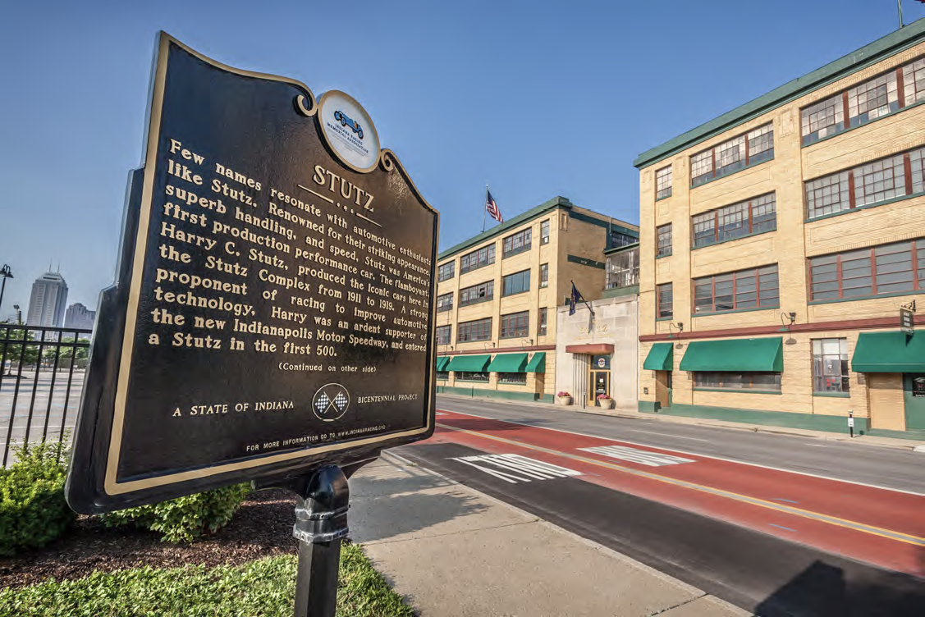


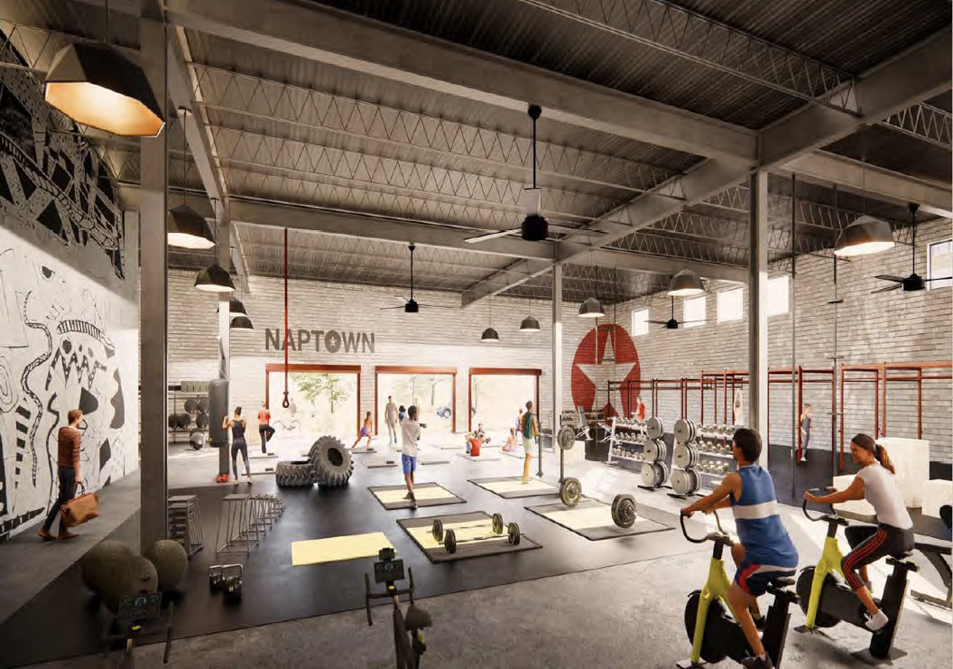
STUTZ BUILDING – Indianapolis, IN

Slide 7
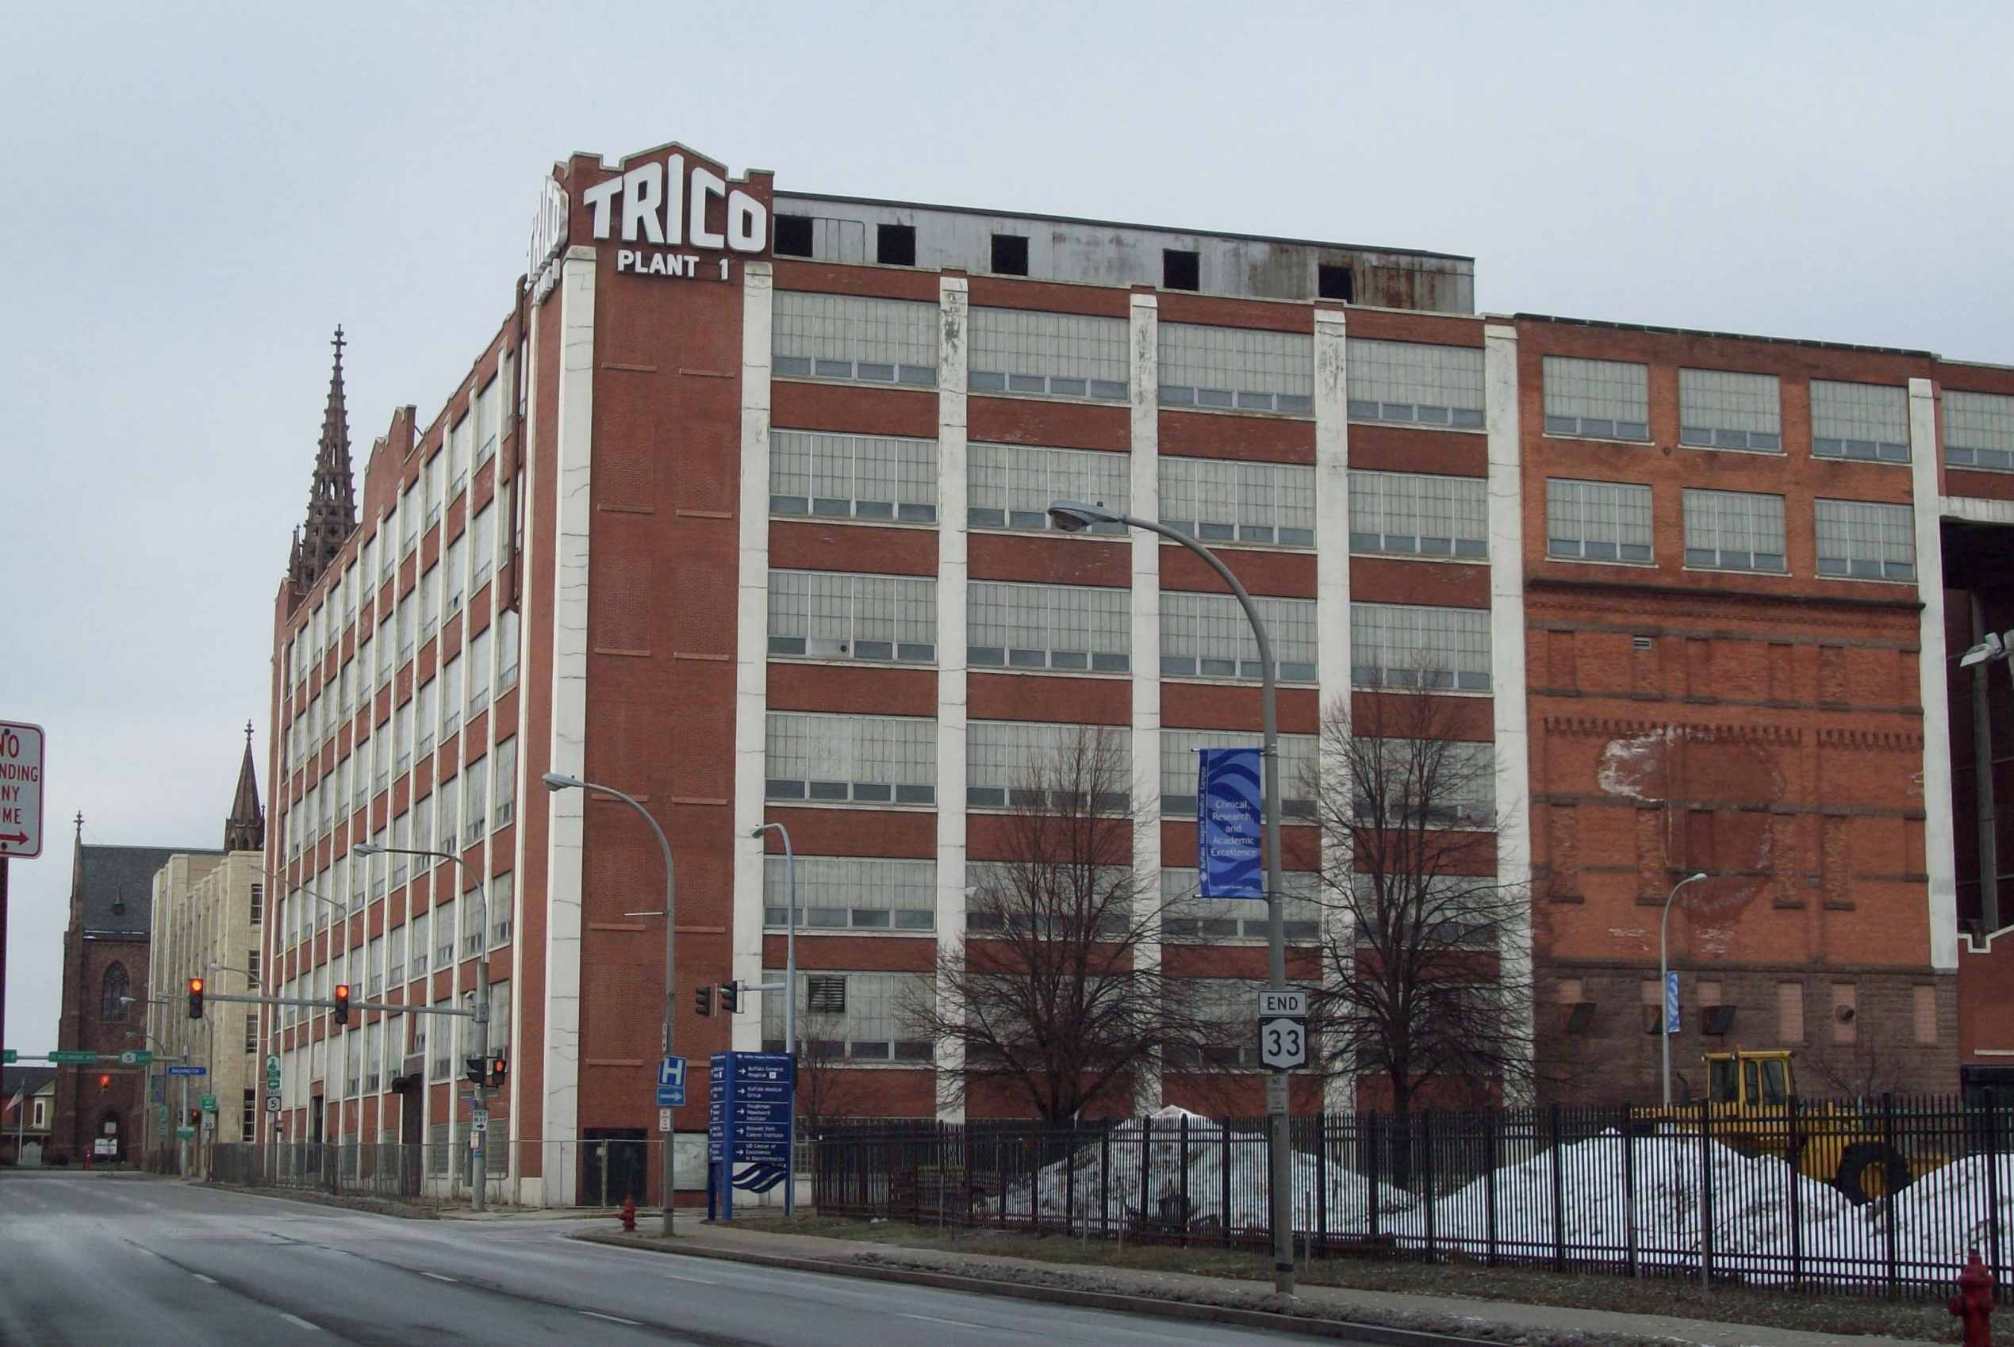
TRICO BUILDING – Buffalo, NY
ABOUT THE PROJECT:
DETAILS
Located in downtown Buffalo, the TRICO Building is the original home of the Tri-Continental Products Company (“TRICO”) and still operates today.
The redevelopment consists of 242 apartment units, 58,000 square feet of commercial space, and 100,000 square feet of covered parking. Apartment amenities include a workout facility, community room, dedicated storage, and indoor parking, while the units will include full laundry appliances, high-quality finishes and 14-foot-high ceilings.
This project is expected to generate $22,527,895 in NY State Historic Tax Equity
TRICO was the inventor of the automatic
windshield wiper which was originally supplied to the Packard automobile factory
Located in the Medical Park neighborhood, adjacent to Allentown and Buffalo Theater District
Trico Building Apartments will also offer furnished short-term corporate apartments.

Slide 8

TRICO BUILDING – Buffalo, NY

Slide 9
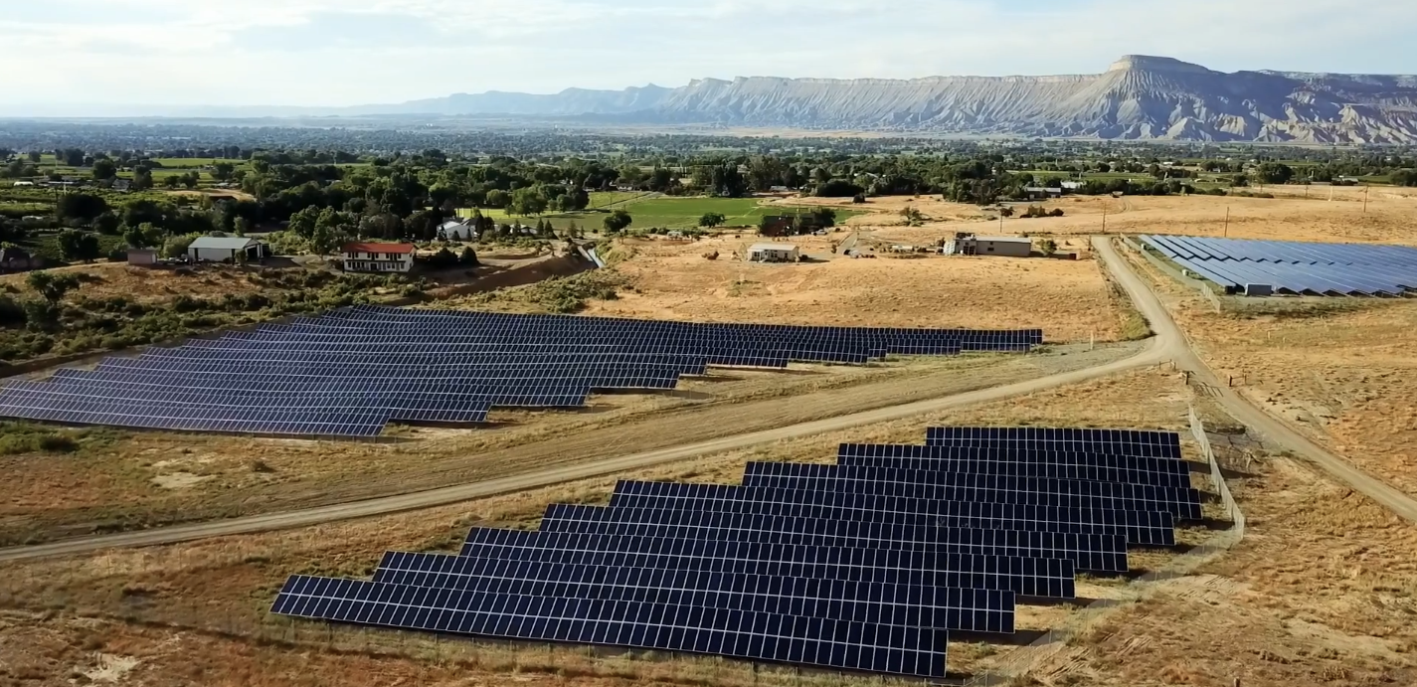
PIVOT ENERGY SOLAR PORTFOLIO
ABOUT THE PORTFOLIO:
DETAILS
A ~$40M portfolio totaling 90MW of distributed generation solar projects across multiple states in the US with Pivot Energy, a national solar provider
The portfolio is comprised of over 40 solar projects
In addition to commercial & industrial (C&I) power purchase agreements (PPAs), clients include community solar subscriptions for commercial clients, residents, and nearly 1,200 low-to-moderate income (LMI) households.
The portfolio exhibits strategic diversity across project types, client offtake arrangements and geographic reach
Projects are located in New York, Illinois, Colorado, Minnesota, California, and New Jersey
Location diversity is beneficial both in bringing clean solar energy to more Americans and strengthening the portfolio's long-term financial outlook
This portfolio will expand access to clean low-cost electricity for small businesses and households

Slide 10
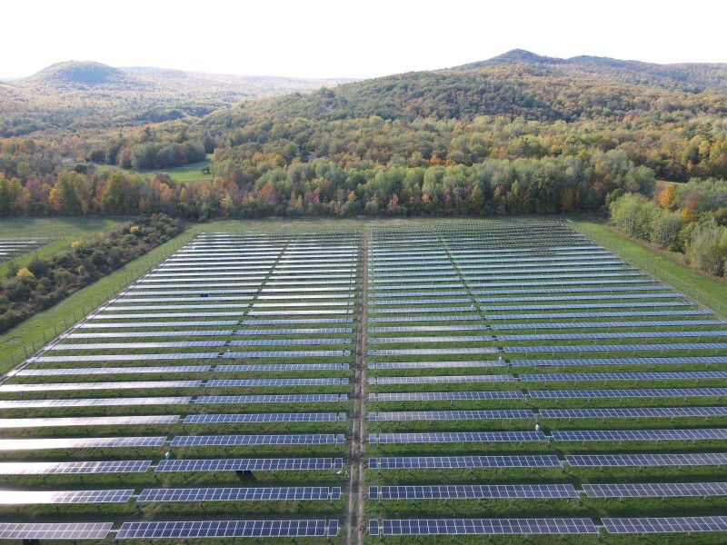
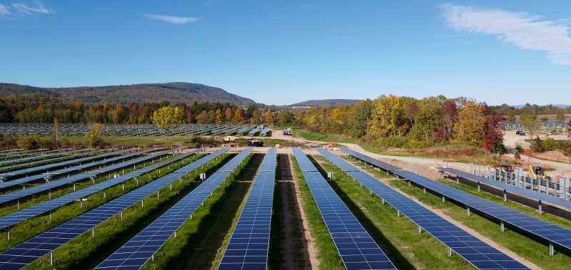
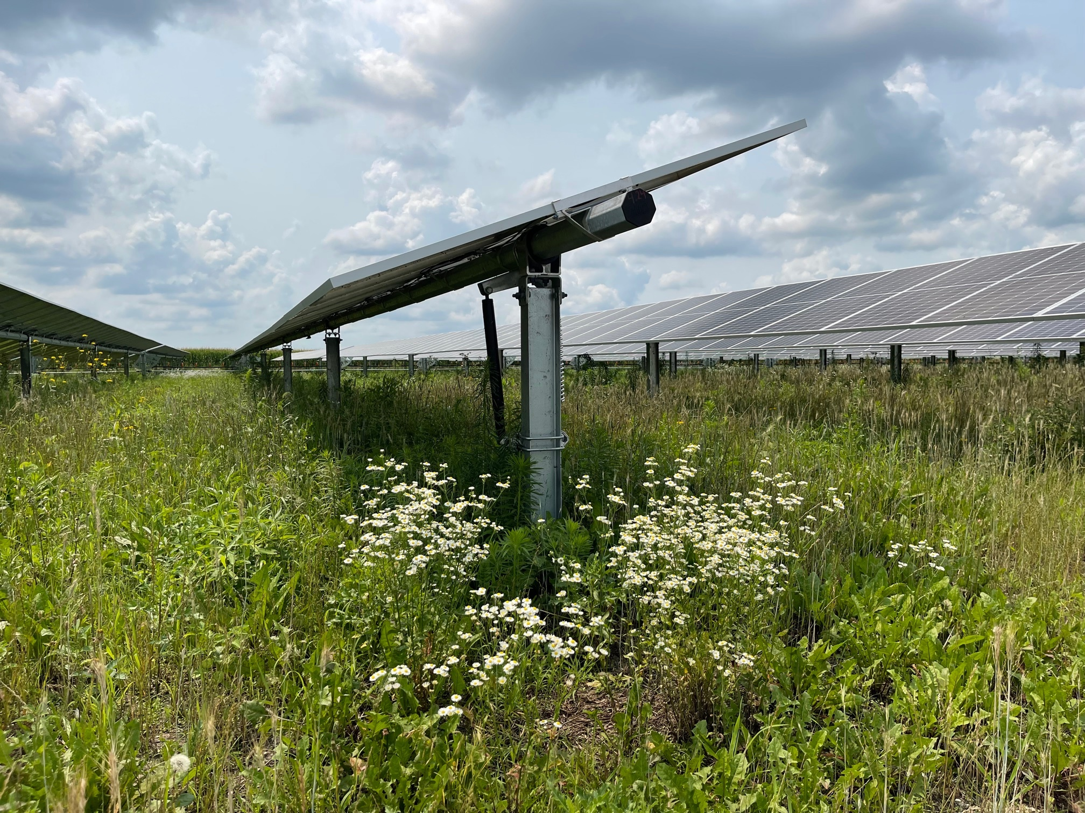

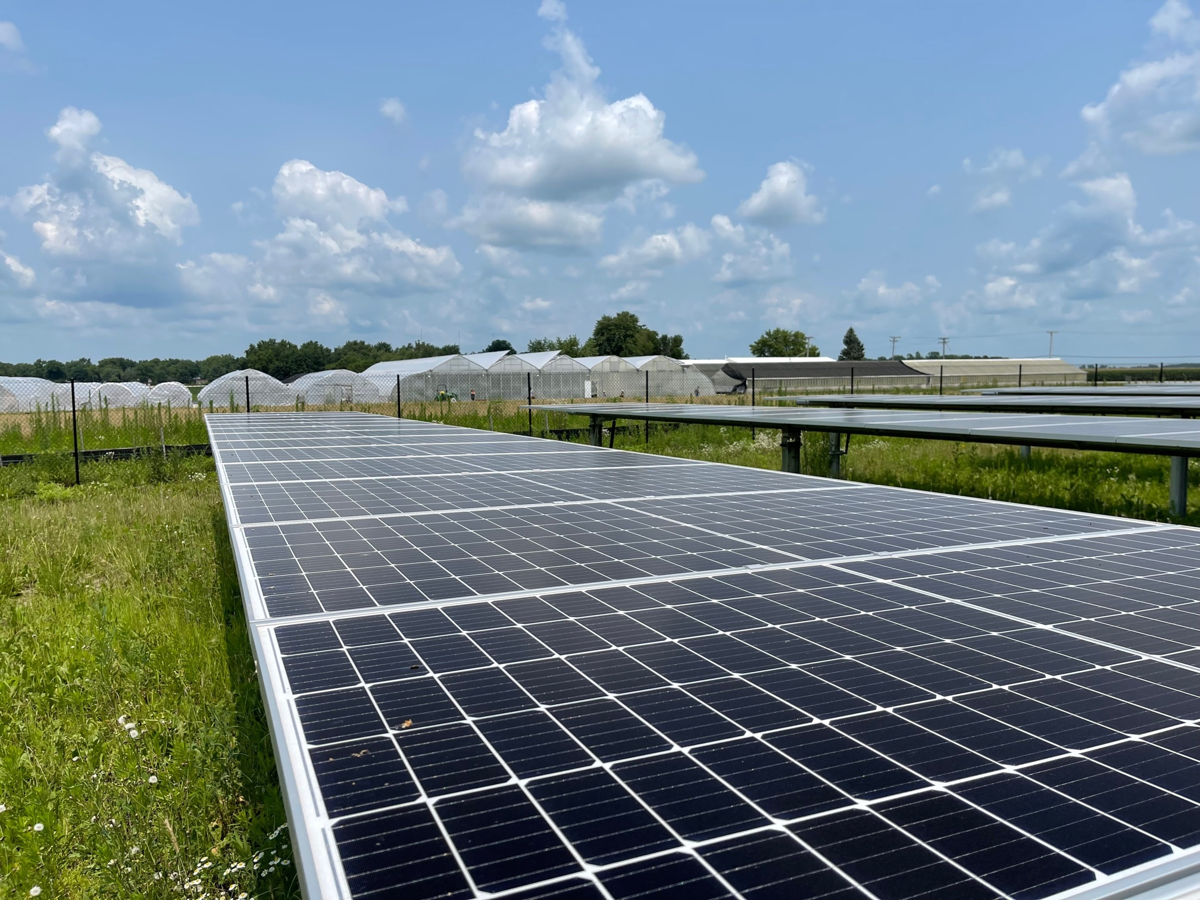
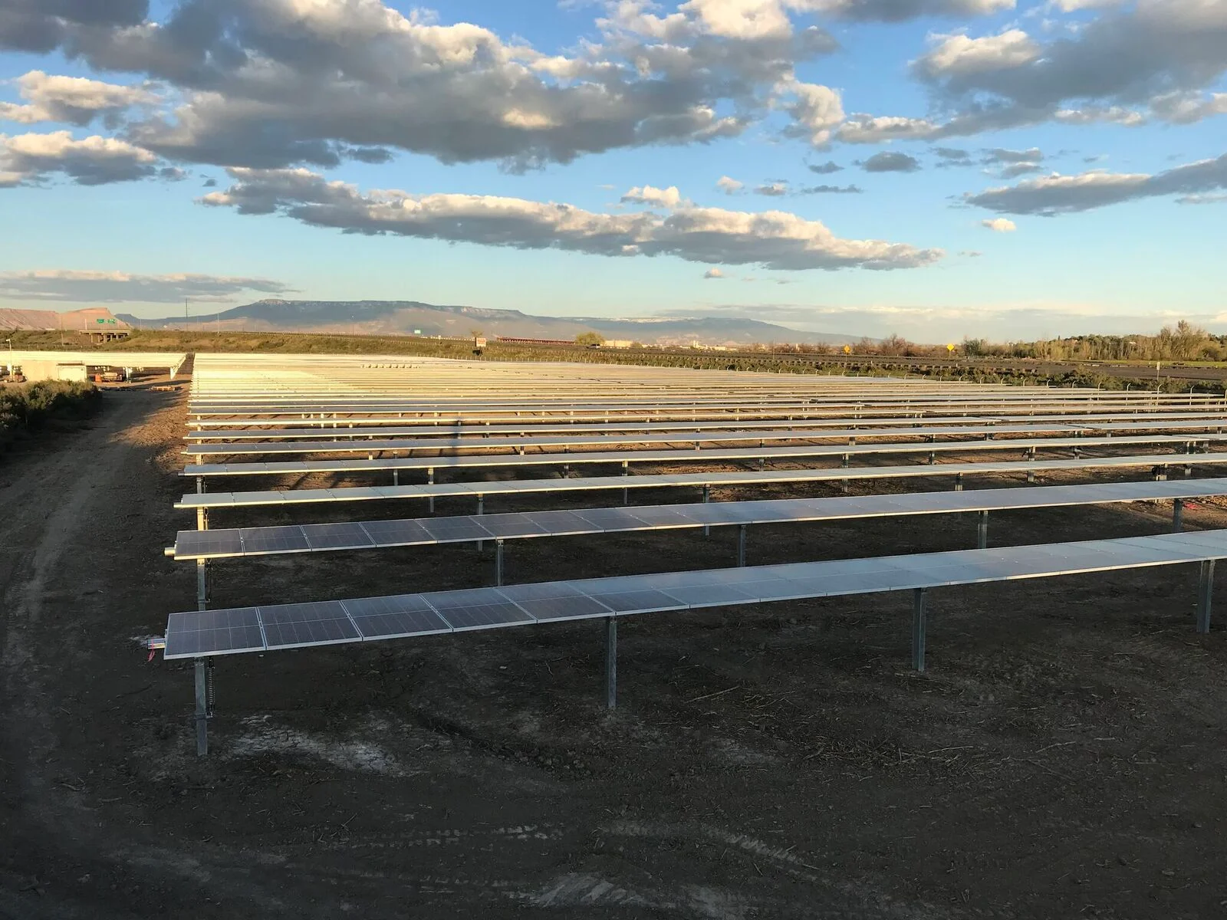
PIVOT ENERGY PORTFOLIO – NY, CO, IL, MN, CA, NJ

Slide 11
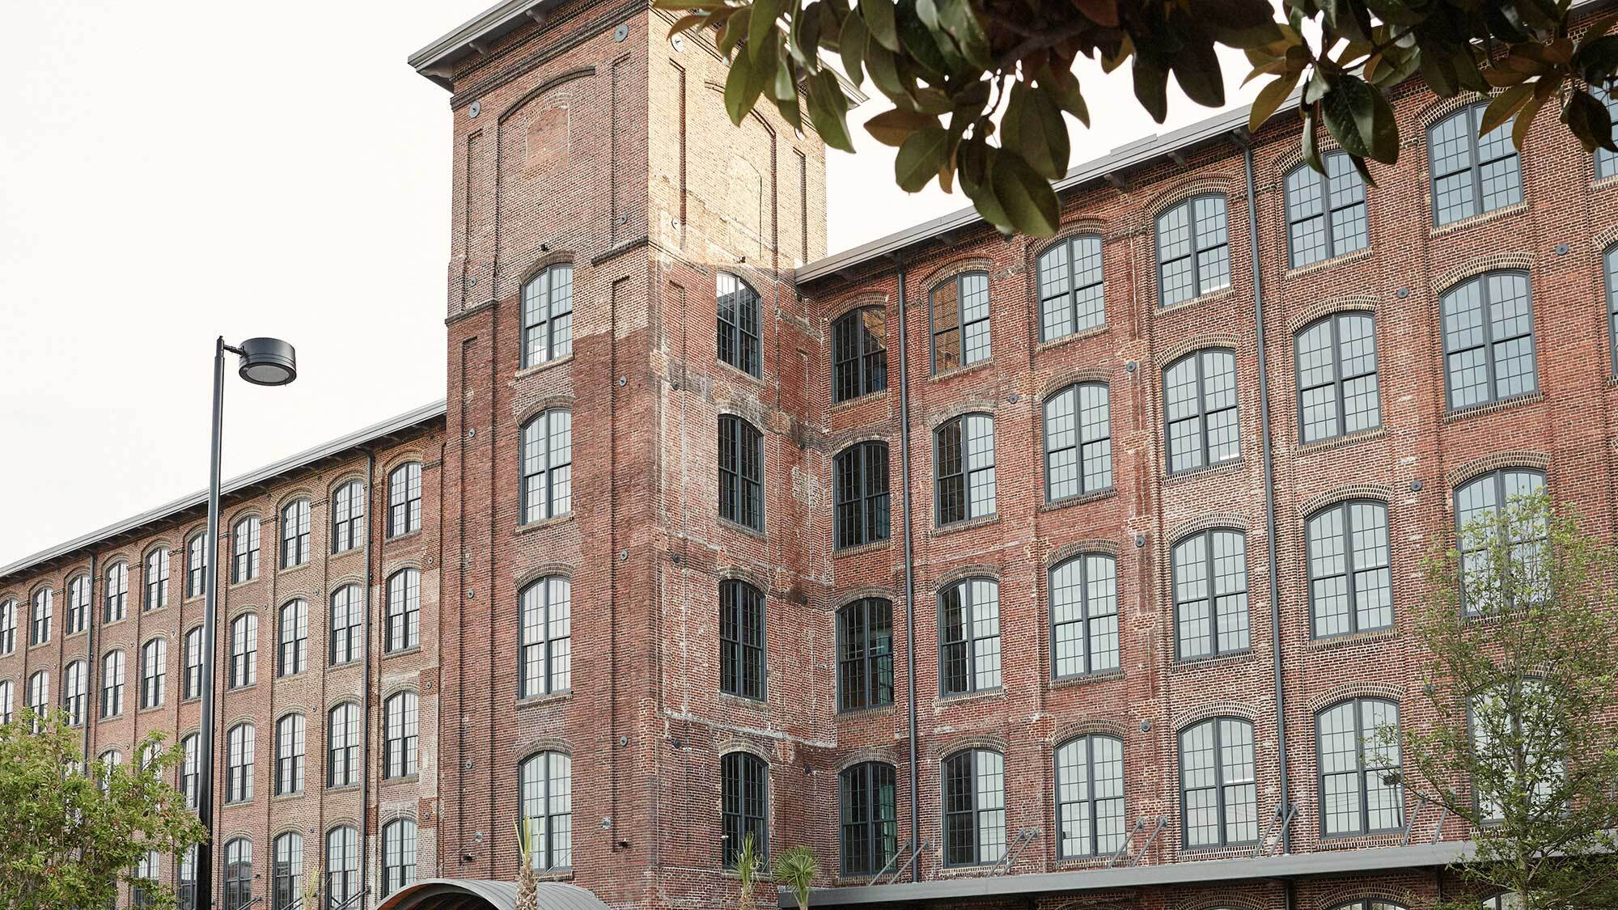
JOHN SOREL
Acquisitions
JSorel@fossandco.com
973-525-9324

Slide 12
Thank you!
Market Update & Trends
Scott Sergio
  Nixon Peabody LLP
  Moderator
Amanda Bloomberg
  National Trust Community Investment Corporation
Melissa McCormack
  JPMorgan Chase
John Sorel
  Foss & Company
Daniel Rolfe
  Bank of America

